Slide 1

Jon Nordling

Slide 2
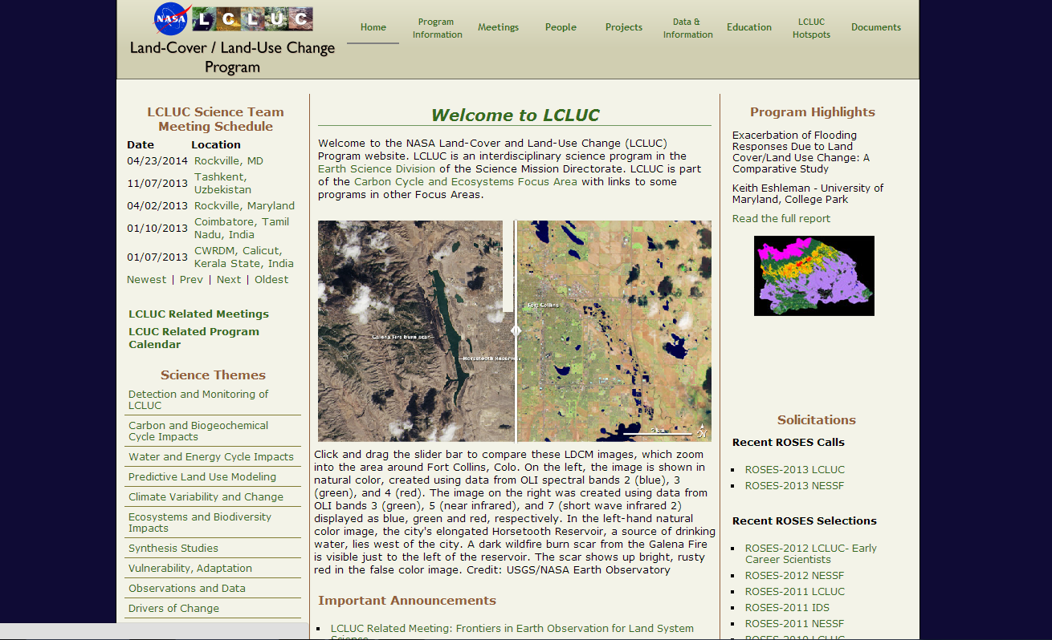
Land Cover land Use Change

Slide 3
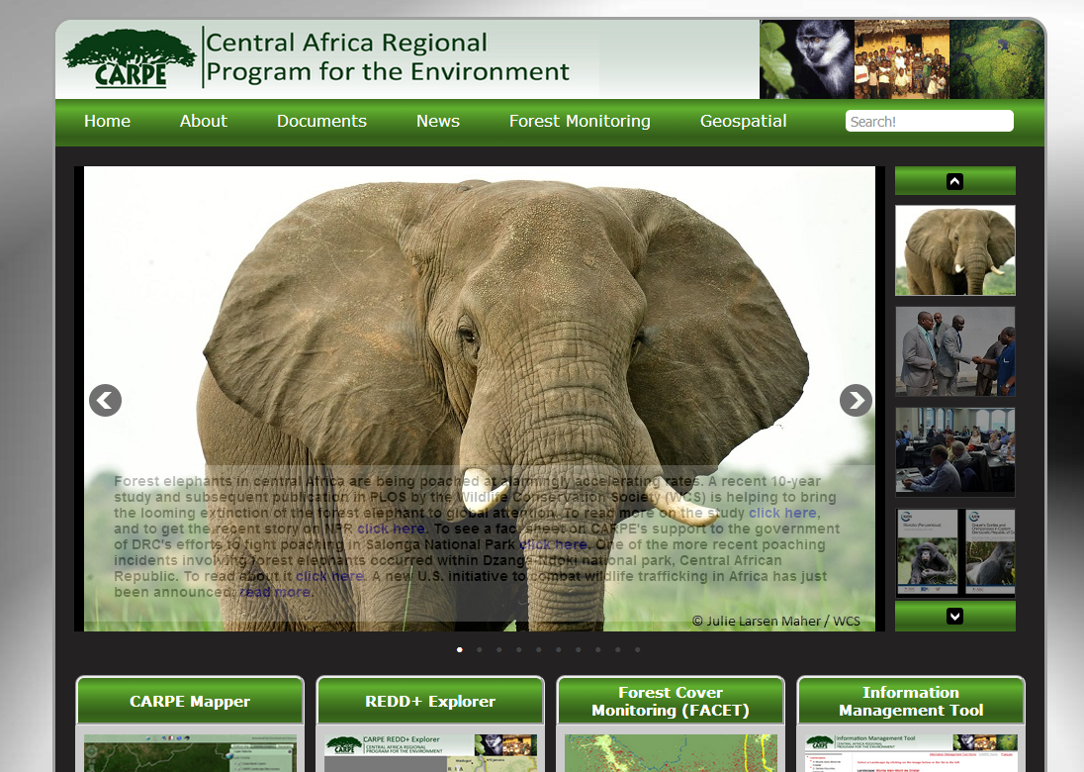
CARPE

Slide 4
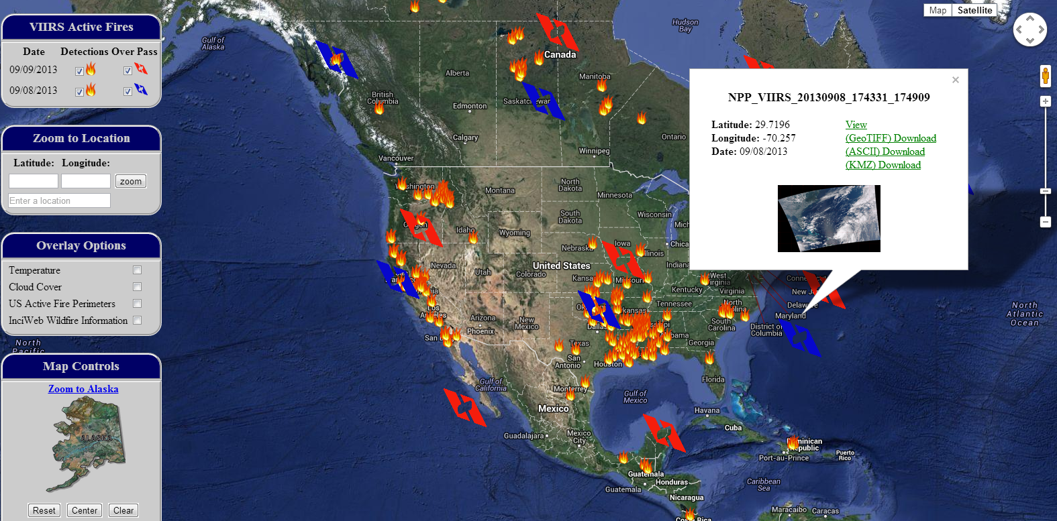
VIIRS Active Fires

Slide 5
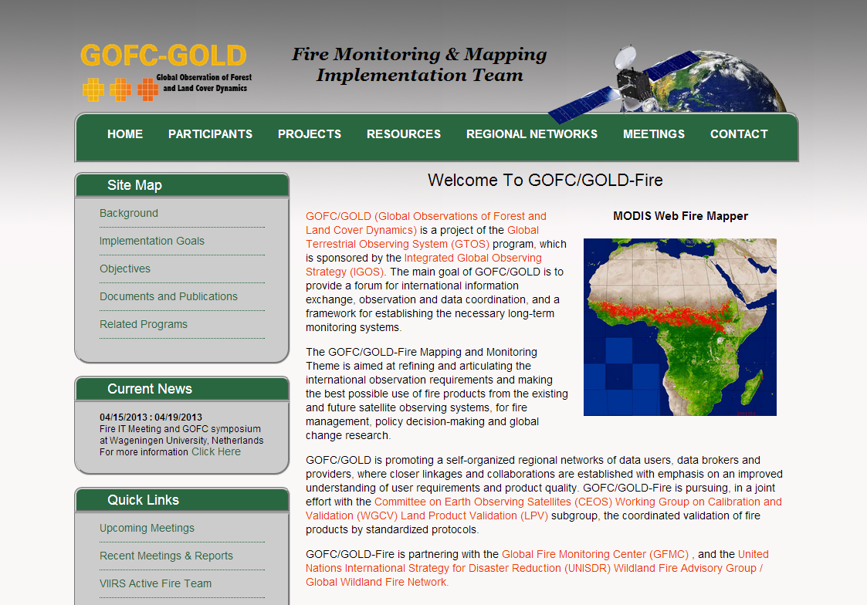
GOFC-GOLD

Slide 6
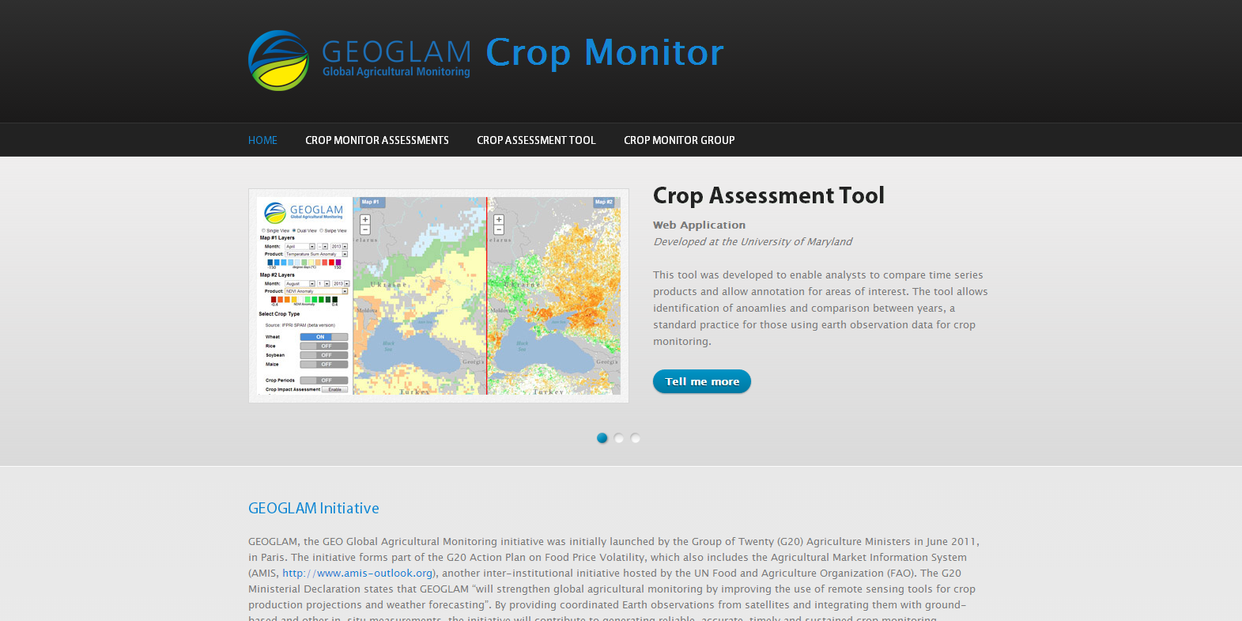
GEOGLAM

Slide 7
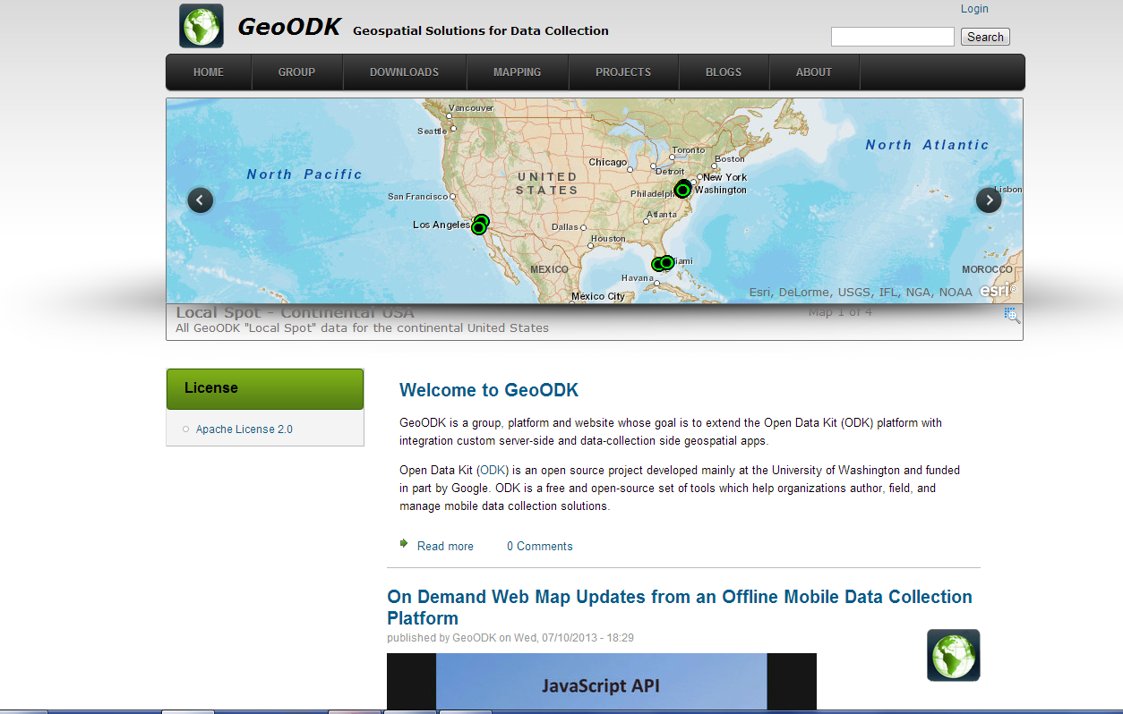
GEOODK

Slide 8
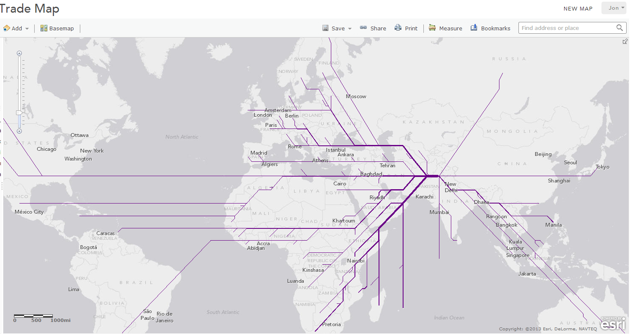
Food System Model

Slide 9


Mobile Agricultural Geo-Tagging Information System (MAGIS)

Slide 10
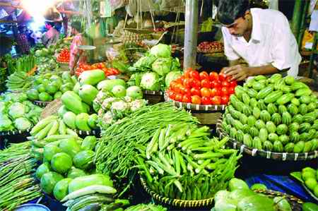
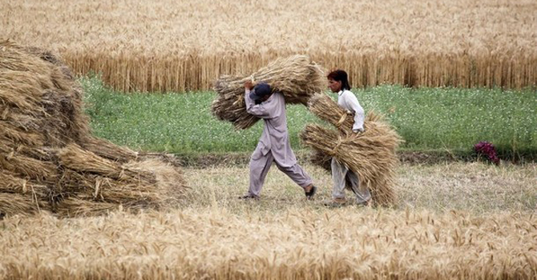
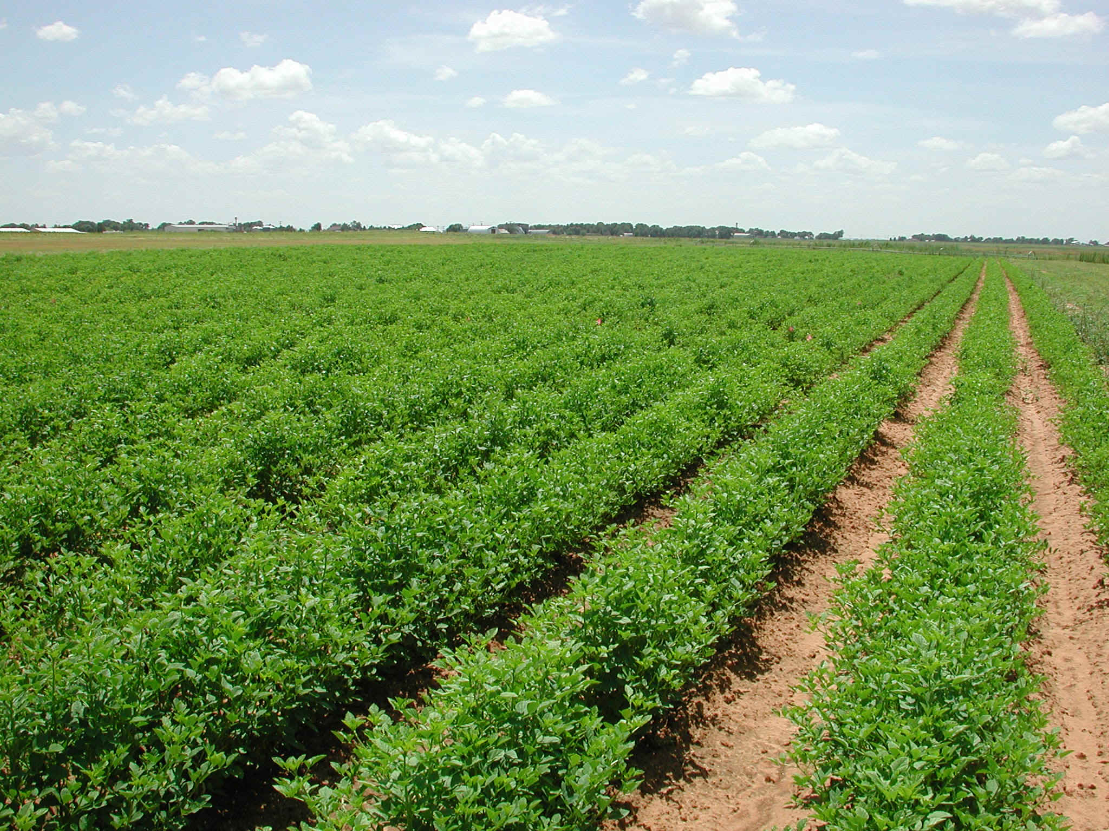
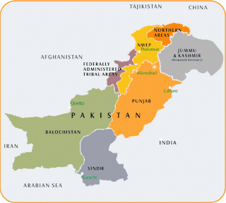
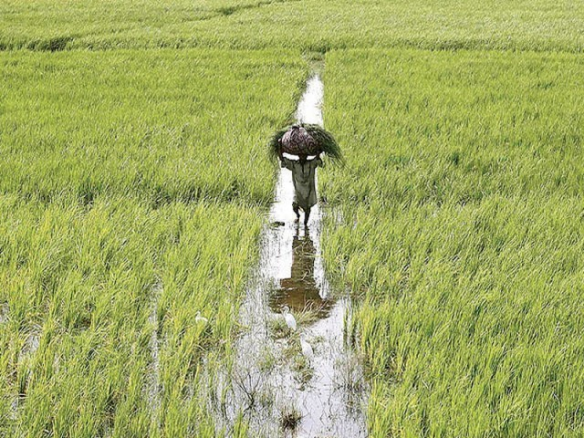

Slide 11
Traditional App Development
App
Input

Slide 12

Agriculture Variables
Different time & season
Different weather & climate
Different crops
Different location
Different needs of agriculture
App
Input

Slide 13
Expandable Model
Input
Input
App
Input
Input
Input

Slide 14
MAGIS APP’s Main Focus
Provide a smart phone application for the Crop Reporting Service that integrates their current methods and master list frame with a digital form their system.
Provide the CRSs with a way to view/visualize and export their data in a format that can be used to generating their reports. Such as area/crop yield etc.

Slide 15
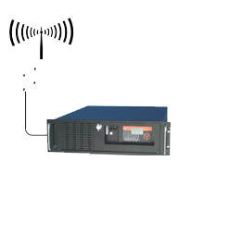
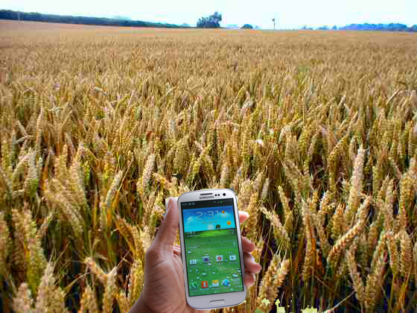

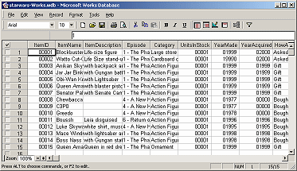
Application Workflow
Collect Data
Send Data
Analysis Data
Aggregate Data & Stored in Database

Slide 16
Data and Forms
Custom Forms
Ability to have multiple forms.
The different forms that the crop reporters use.
Crop Reports will be able to change, customize, alter the there forms for further data collection.
Simple Microsoft Excel document used to generate custom forms and exported in a format compatible with the application.

Slide 17
Form Capabilities
GPS- Locational Data
Latitude/longitude
Accuracy meters
Image of collection
Form text based information (conditional)
Form based data (Text, Numbers, calculation)
Third Party Apps
Orientation of image

Slide 18
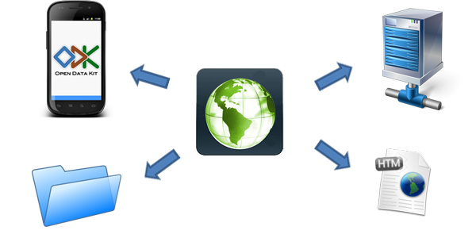
Applications Fundamentals
Formed Data Collection (ODK)
Geospatial Application (GEO Apps)
Local Storage on Device
Database and data access
Visualization tools

Slide 19
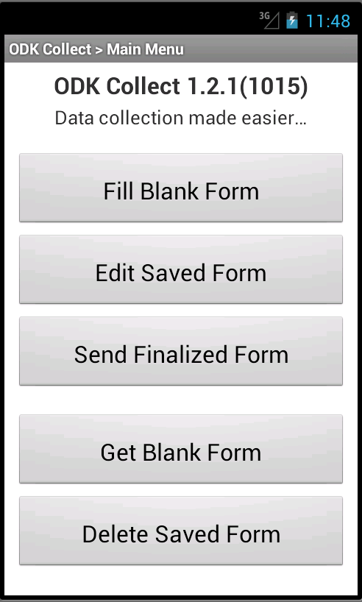
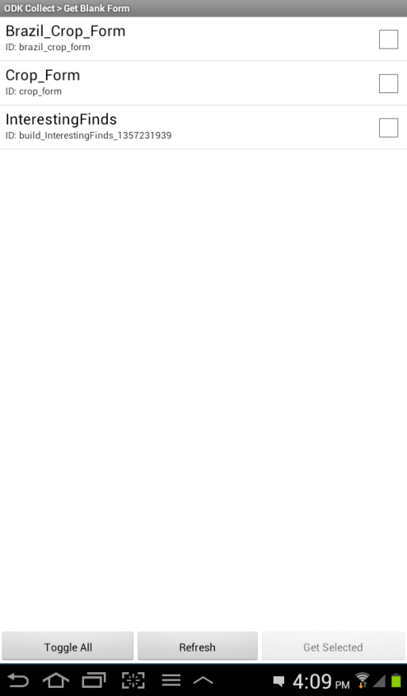
How the App Works
Fill out new forms
Edit previous form
Send Final Form
Get and Delete old forms
** Local Storage

Slide 20
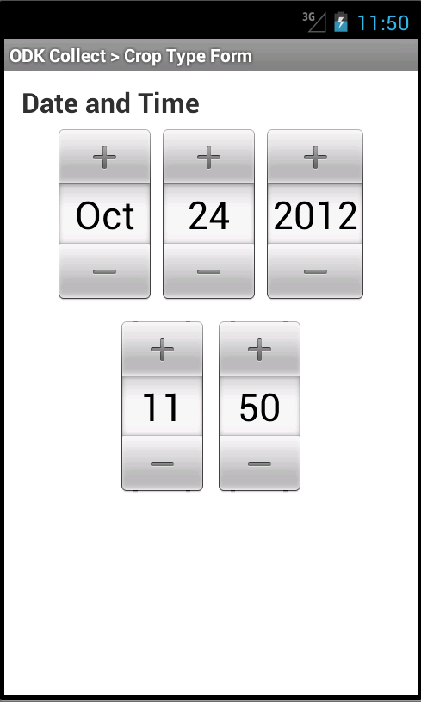
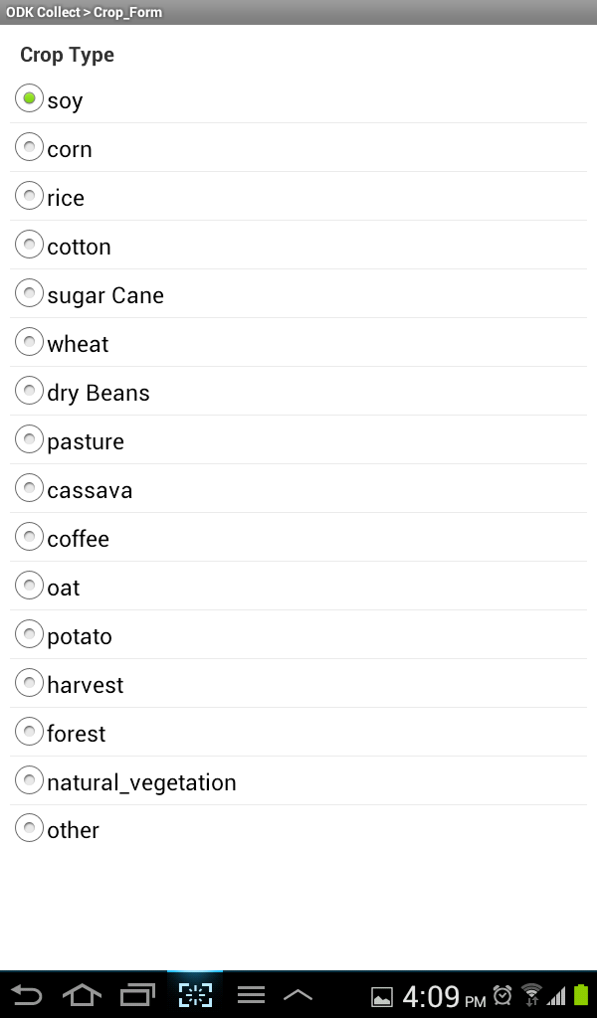
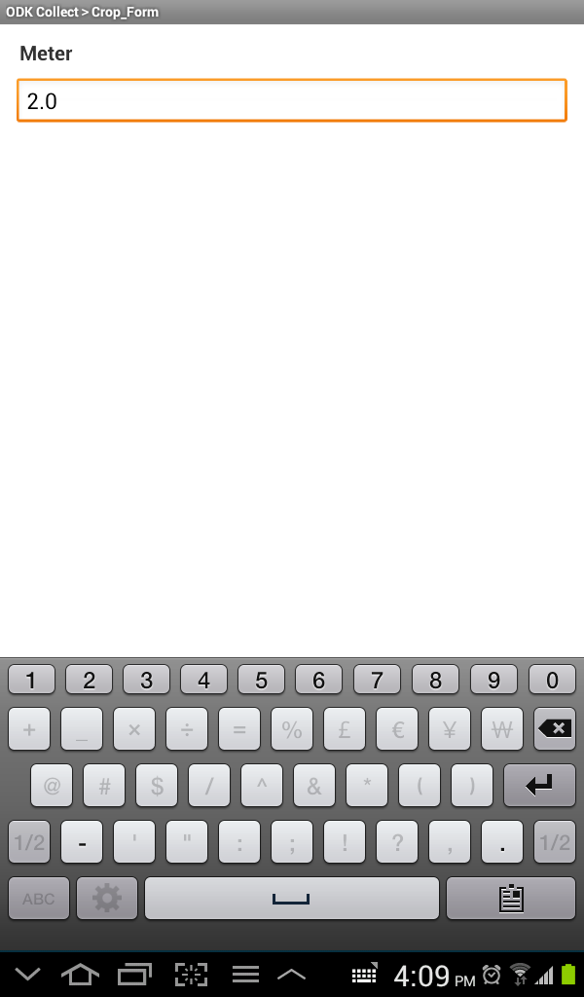
Data Collection Options
Date/time
Select options
Measurements
(Based of previous Selections)

Slide 21
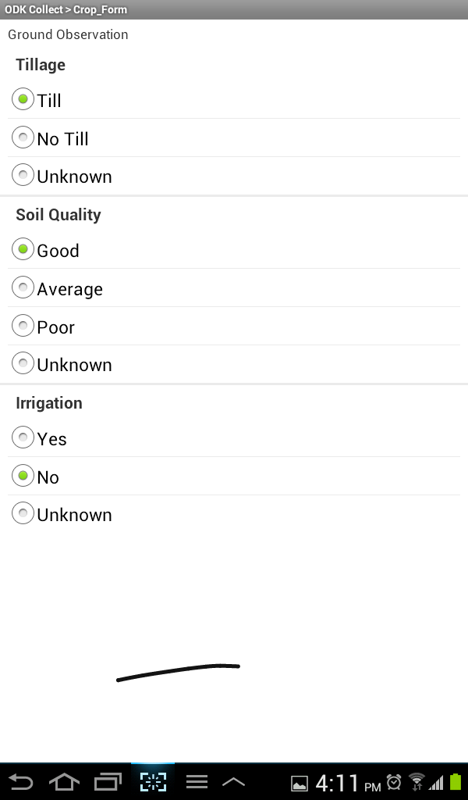
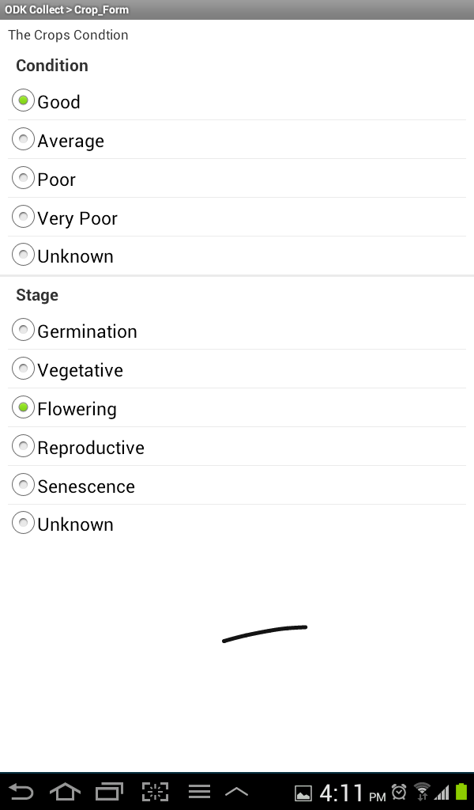
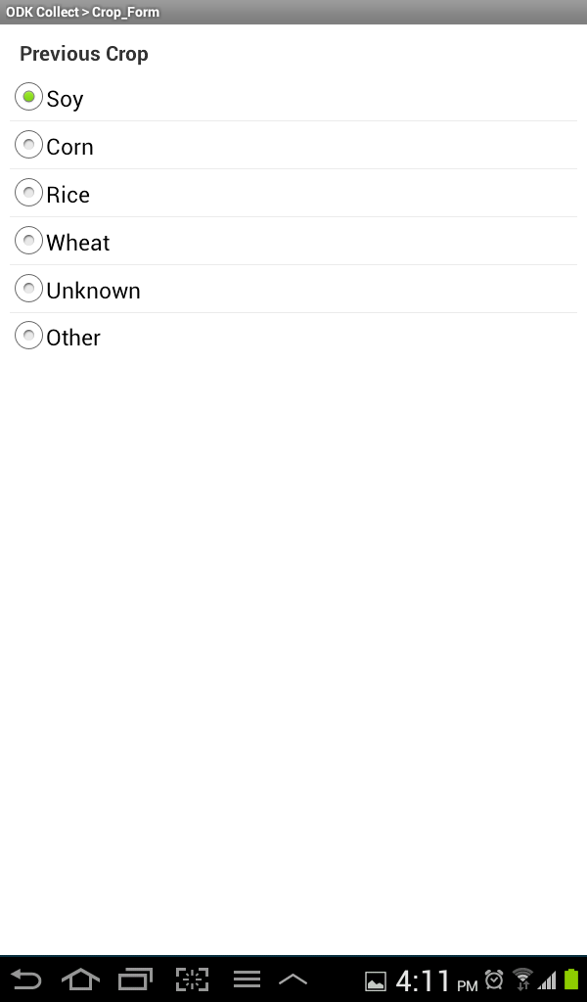
Data Collection Options

Slide 22
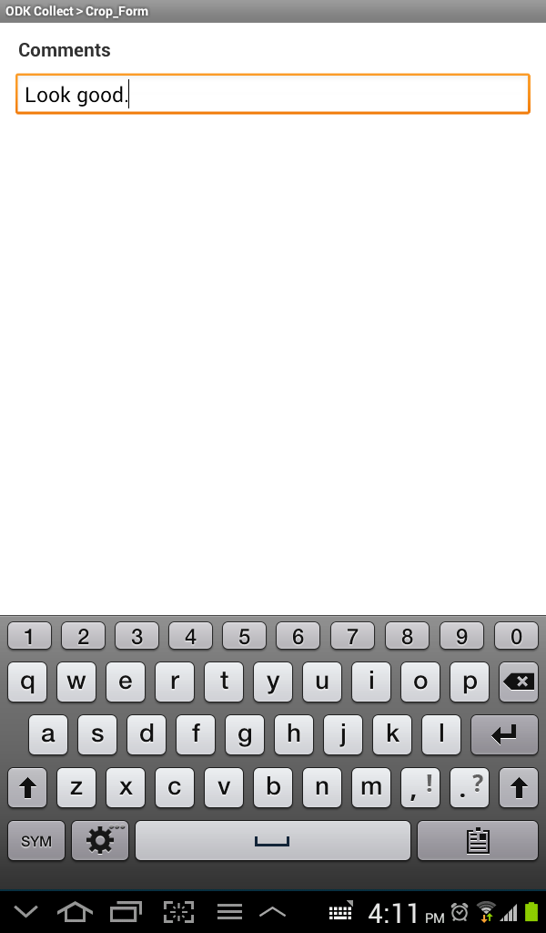
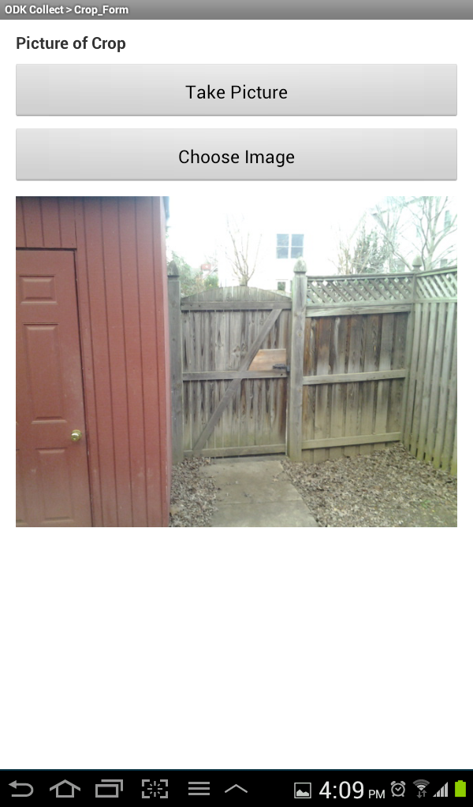
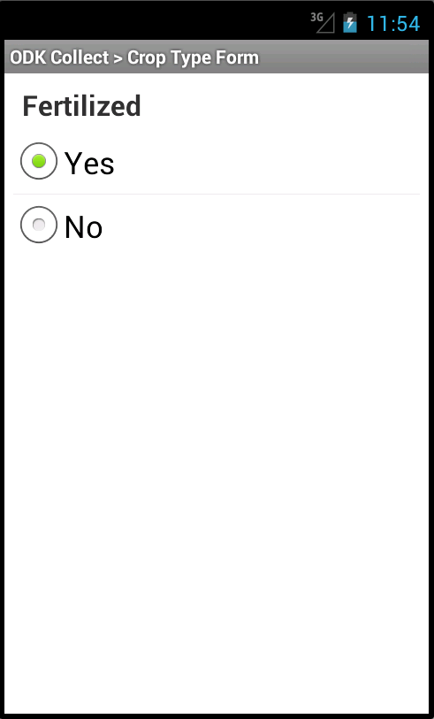
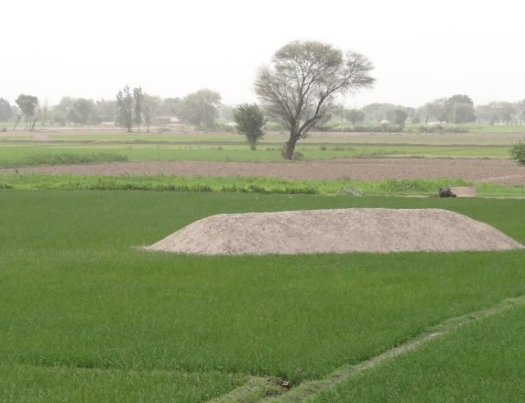
Data Collection Options
Boolean Question
(Yes or No)
Take Image
Text Entry

Slide 23
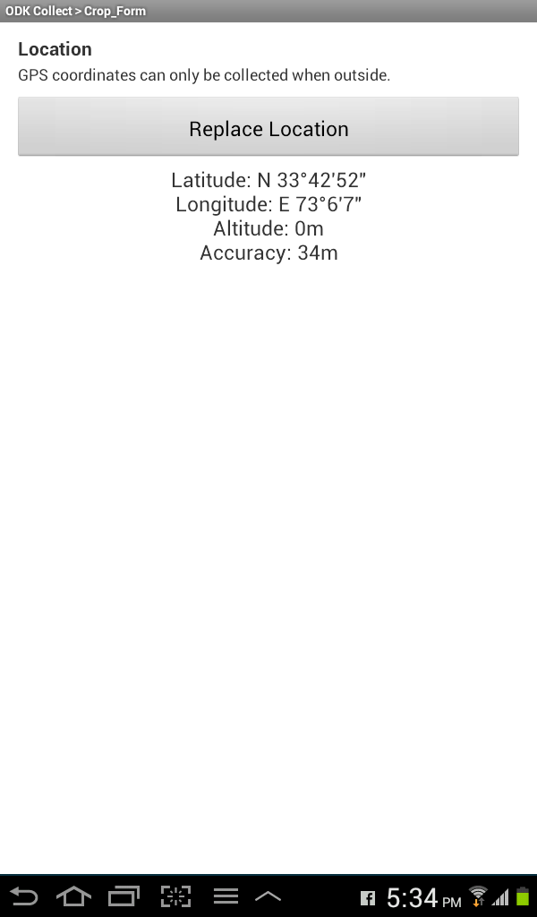
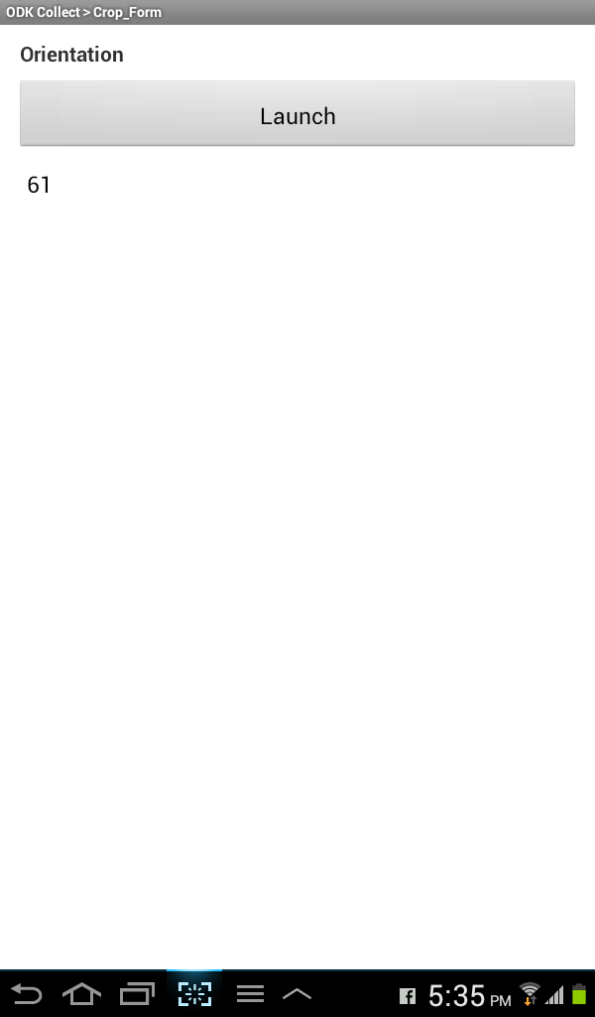
Data Collection Options
Using Device GPS
Take Image

Slide 24
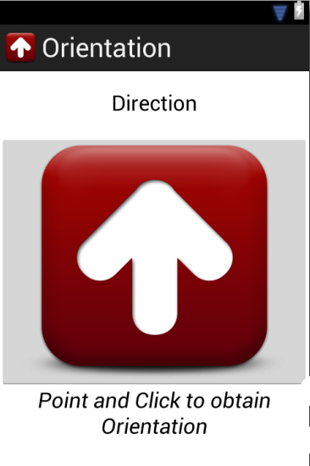
GEO Apps
Making geographical stand alone apps that work with data collection

Slide 25
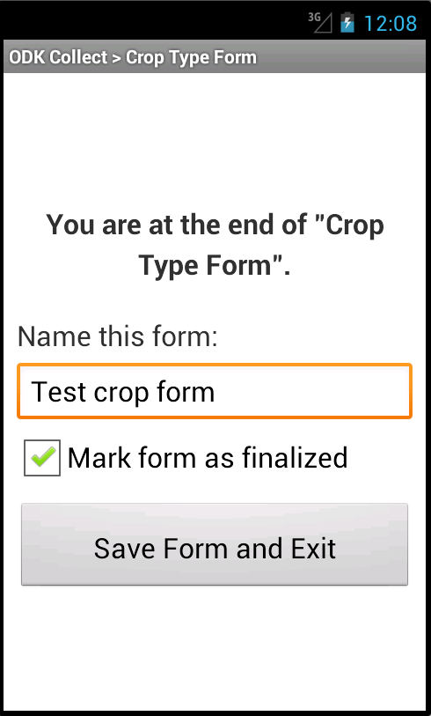
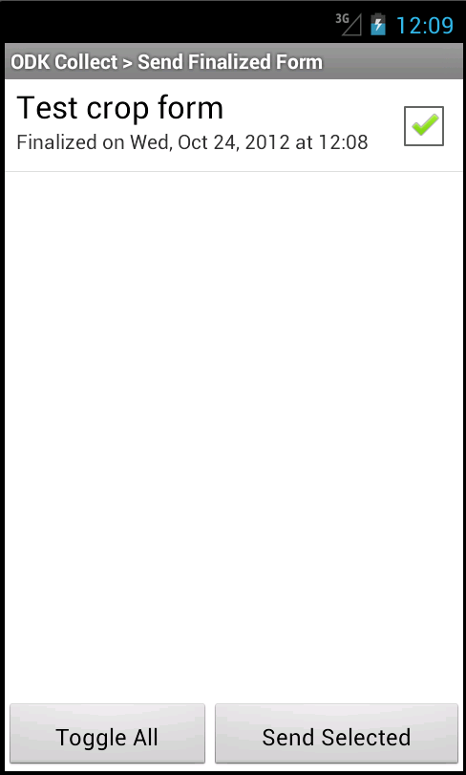
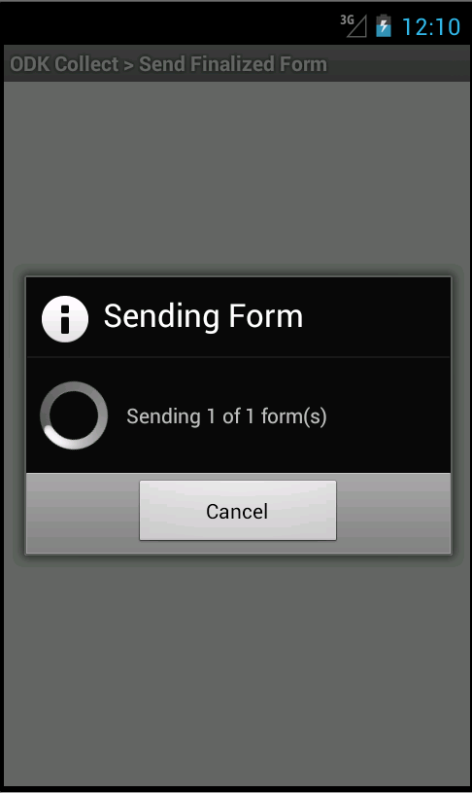
Submitting Data
** The data will be stored locally until submitted

Slide 26
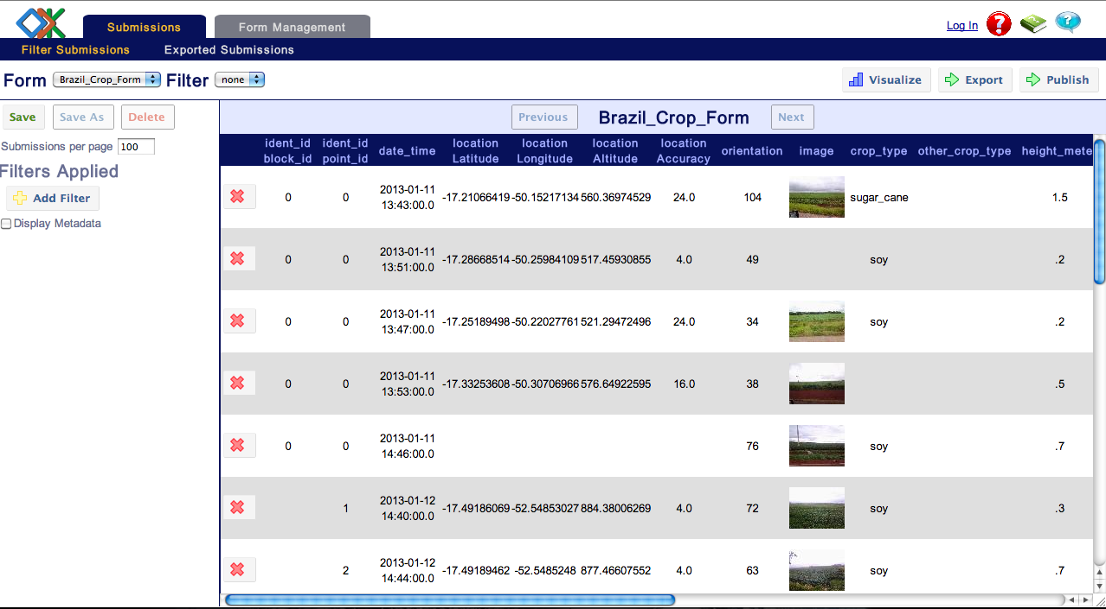
Web Visualization

Slide 27
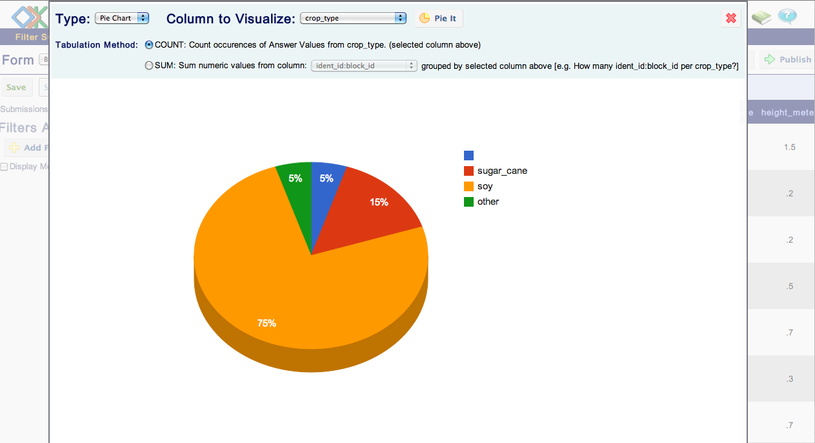
Visualizing Data Pie Chart

Slide 28
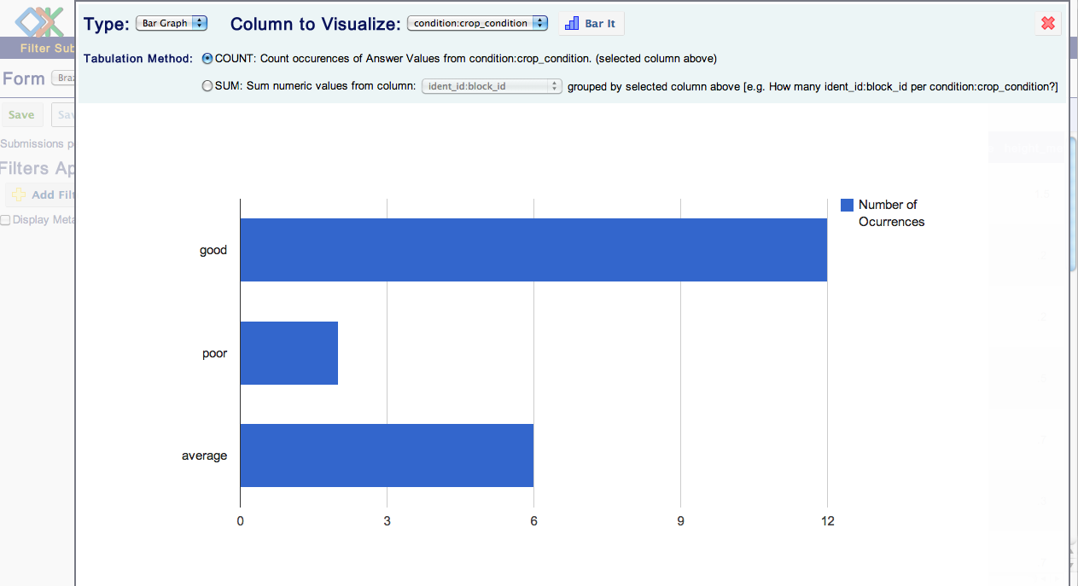
Visualizing Data Histogram

Slide 29
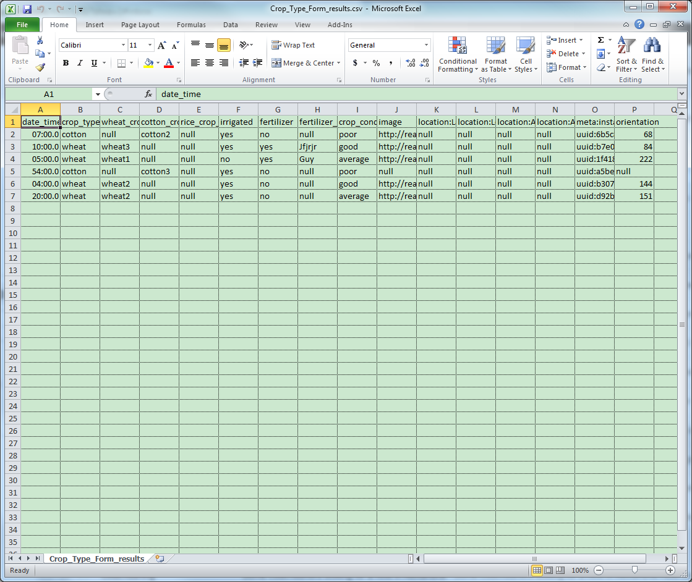
Data Access

Slide 30
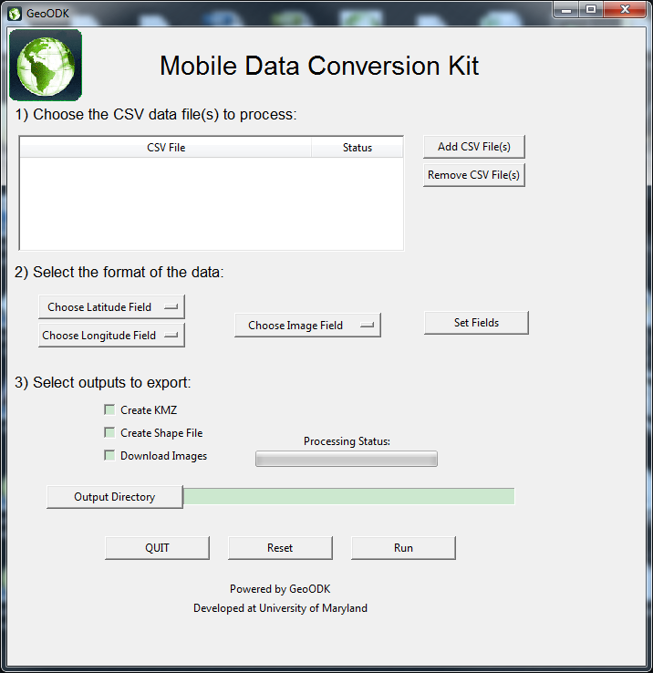

Slide 31
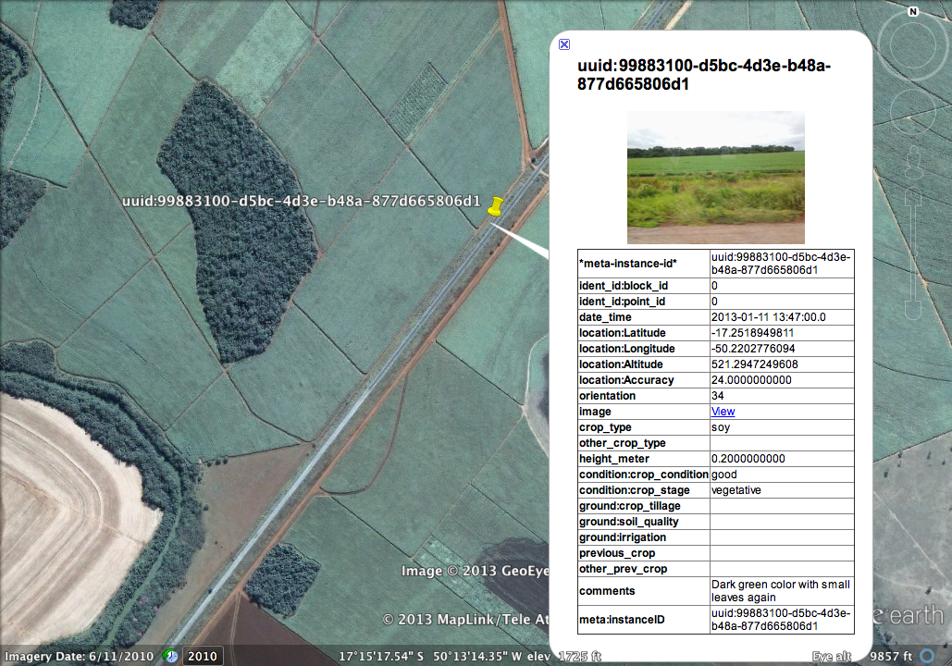
Visualizing On Map

Slide 32
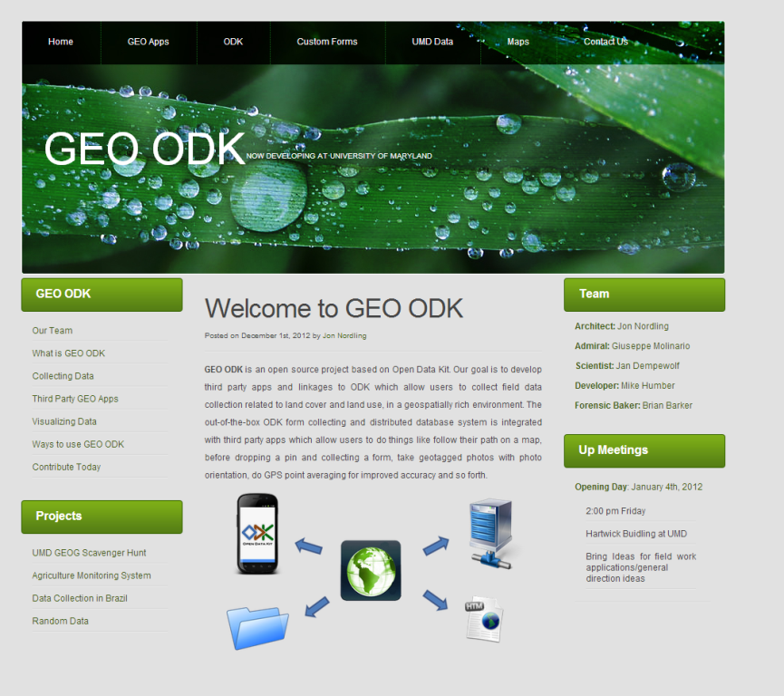
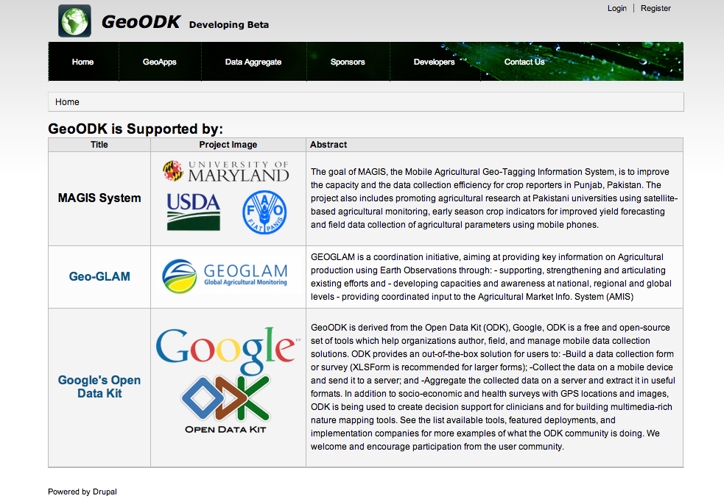
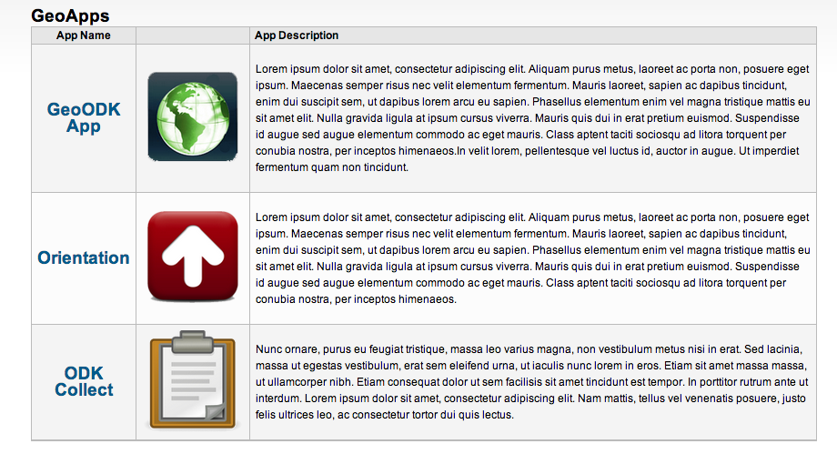
GeoODK
Geoodk.com

Slide 33


Technical Overview

Slide 34
Field Data to Web Map: What’s in Between?
Data transfer model
MySQL (security settings)
Server-side Python script
File geodatabase
Back-end map service components
Map Document
Linux Server
REST service layer
Front-end interface
ArcGIS for JavaScript API accessing the REST endpoint

Slide 35
Method Diagram
ODK
Collect
Form
Web Map
MySQL
Near Real Time Mapping
Diagram
Arc JavaScript Api
Map Doc .MXD
Rest
Map.MXD
Python
Map Doc .MXD
Arc Server
Arcpy
Geodatabase
MySQLdb

Slide 36
Data Transfer Model
GeoODK is backed by a MySQL or PostgreSQL Database.
The python script uses the MySQLdb module to connect to MySQL and execute SQL queries
The script copies data from a MySQL table into the file geodatabase and uses the ArcPy module to create geometry objects based on the lat/lon fields in the MySQL table
File geodatabase is accessed by the REST service to provide data for the web map layer
Model can be bidirectional in practice
MySQL (Linux)
Python Script (Windows)
File Geodatabase
(Windows)
MXD/REST Service

Slide 37
Advantages of Using the Data Transfer Model
Gets the data into the ArcGIS stack
Python and ArcPy provide convenient methods for creating spatial data and give more options for data manipulation
Updates are reflected in near-real time on web maps
Script can be launched automatically using CRON or Windows Task Scheduler, or on-demand using PHP, WAMP CGI, etc.

Slide 38
File Geodatabase vs. RDB/ArcSDE Geodatabase
Both work fine for the task at hand
ArcSDE allows for many readers and writers, unlimited storage
File geodatabases allow for many readers or one writer, up to 256 TB storage
File geodatabases are generally regarded as faster than RDBMS with ArcSDE
Some features and security are sacrificed when using file geodatabases instead of an RDBMS

Slide 39
Server-side Python Script
Application specific – script varies from data set to data set
Run as frequently as desired
Useful beyond creating point data sets
Intermediate geoprocessing operations (hotspot analysis, buffer, clip, etc.)
Map validation using raster value extraction
Summary statistics

Slide 40
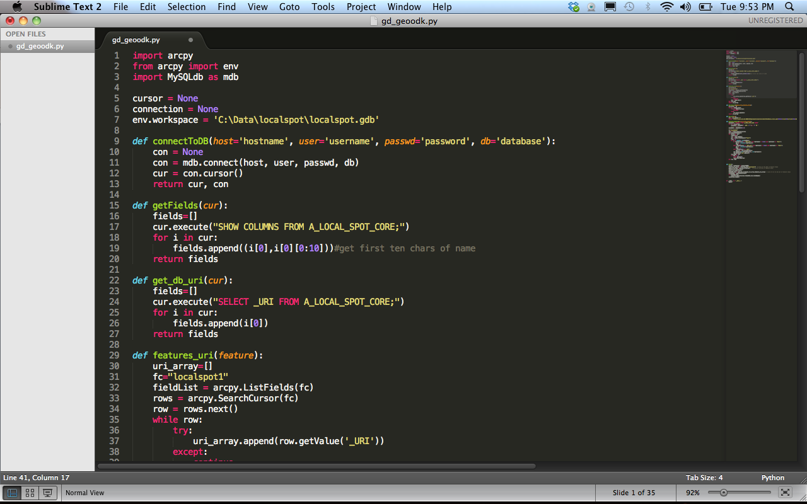
Python Code Samples

Slide 41
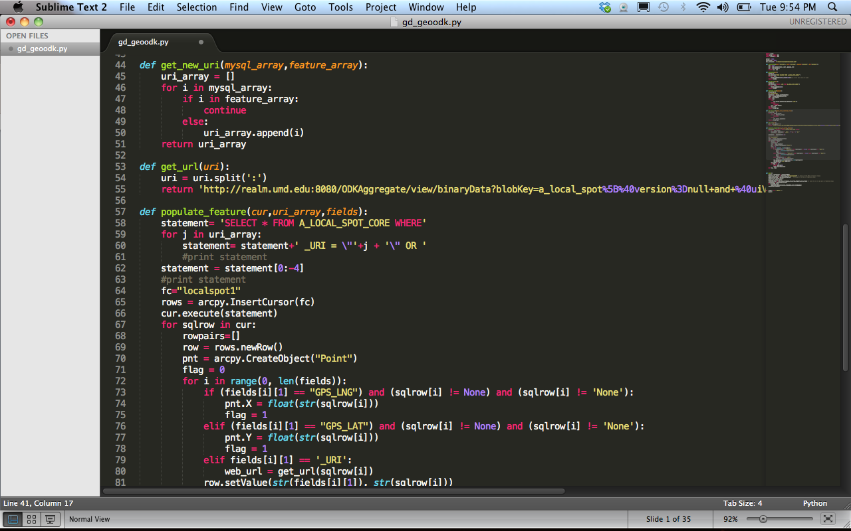
Python Code Samples

Slide 42
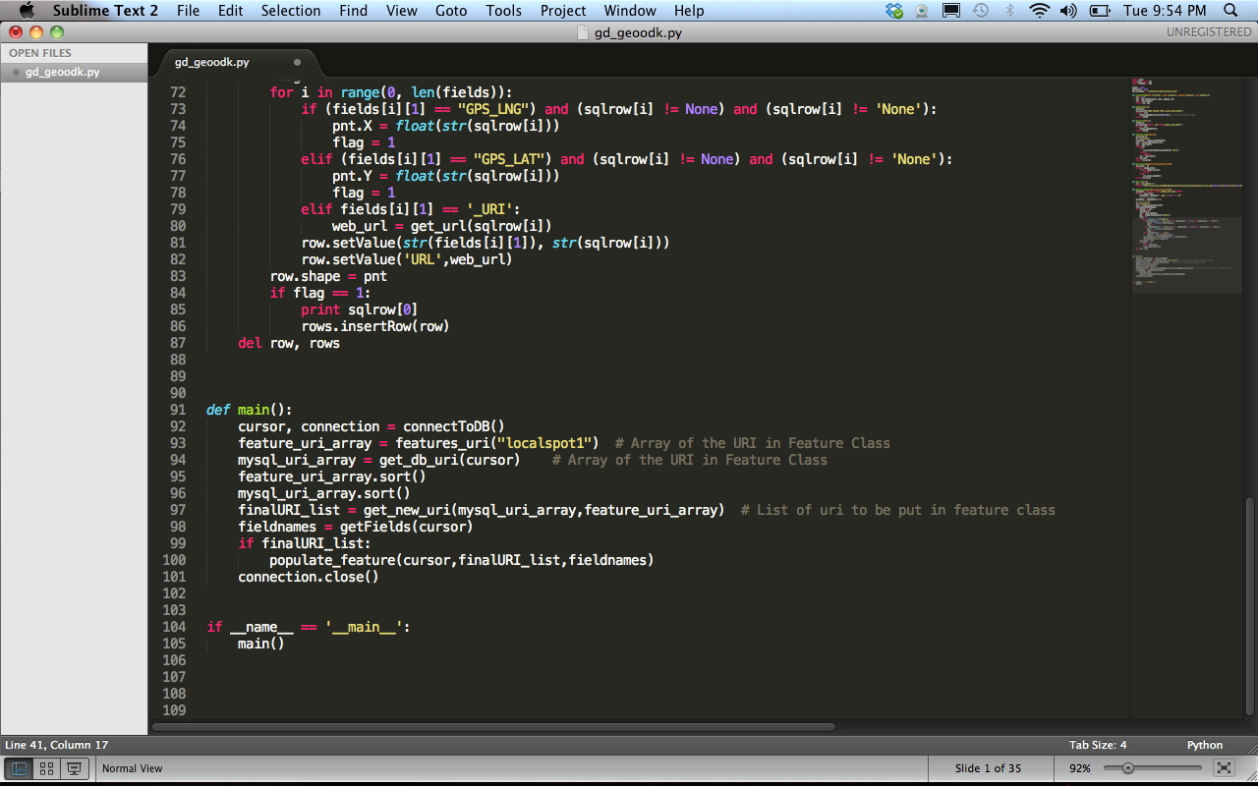
Python Code Samples

Slide 43
Server Stuff
CentOS
*Same file system as file geodatabase
Data layer to be displayed, empty or populated, with the desired field names
Any other data to be accessed by the API’s
Spatial reference set to WGS-84 (wkid: 4326), same as GeoODK coordinates
Layers are accessed through JavaScript API

Slide 44
ArcGIS for JavaScript API
Changes made to the layer are reflected immediately in the web map
Other layers can be added to the API to create a mash-up specific to the project
Ex.: Impervious surface mapping (Joe Sexton)
Pre-defined sampling locations
High resolution imagery
Thematic maps

Slide 45
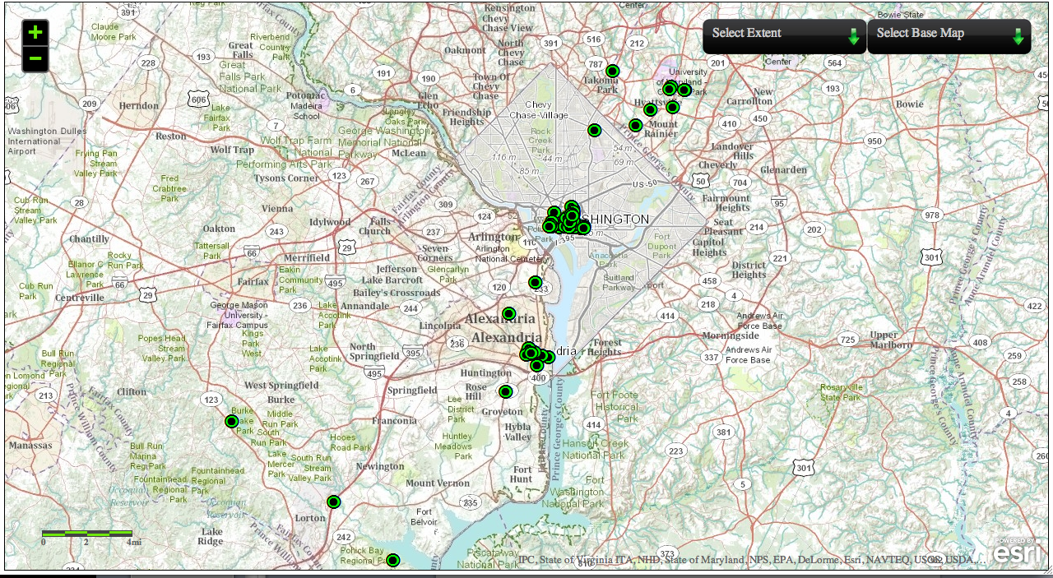
Real-time Mapping

Slide 46
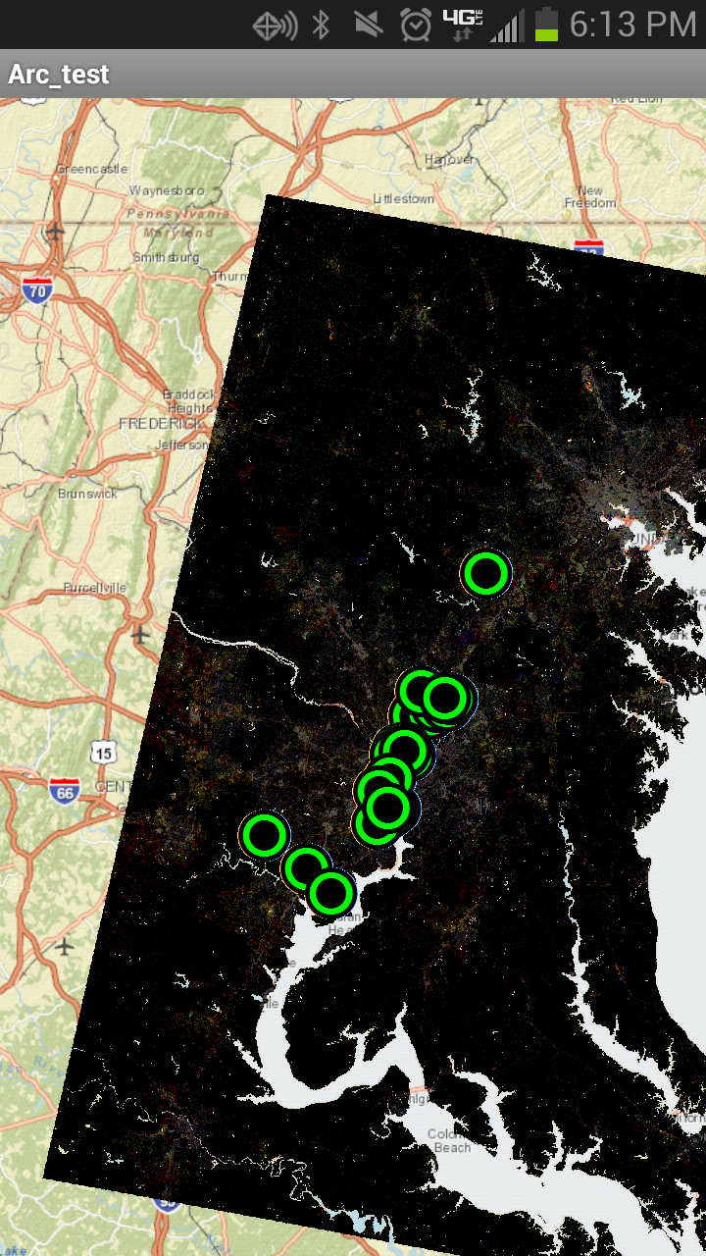
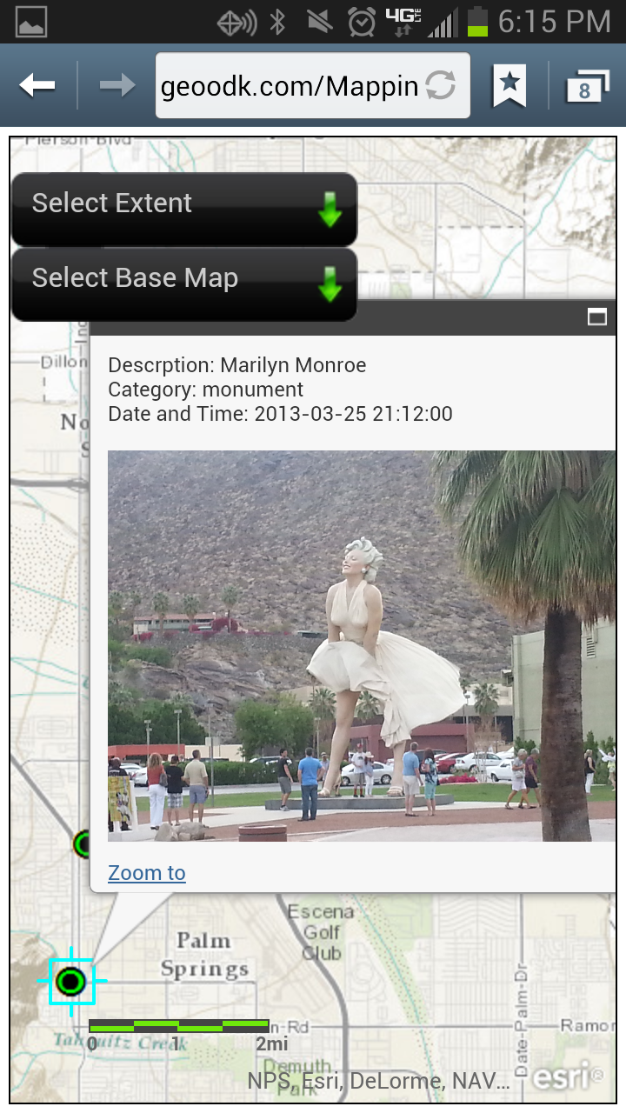
Android SDK

Slide 47
How to creating forms for MAGIS

Slide 48
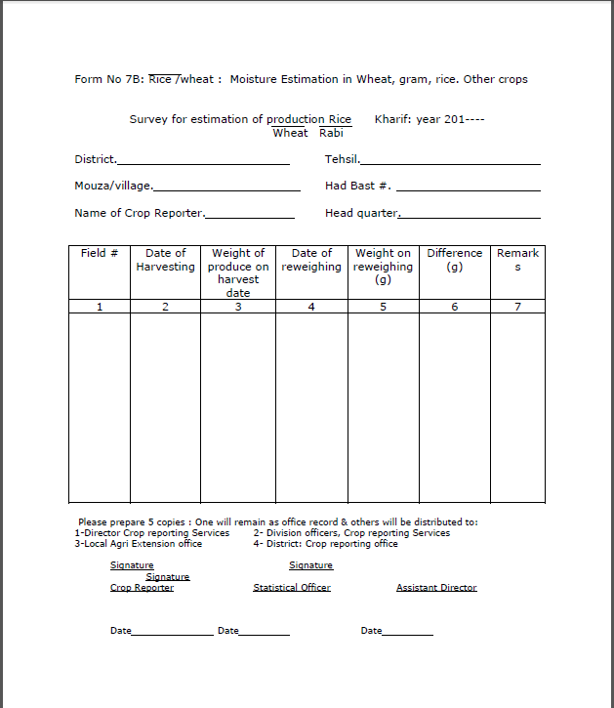

Slide 49


Slide 50

Questions

